Slide 1
Unit 3B
Human Diversity & Change
Inheritance
DNA technology

Slide 2

Study Guide
Read:
Our Human Species (3rd edtn)
Chapter 18, section 10
Complete:
Human Biological Science Workbook
Topic 17 – Biotechnology

Slide 3
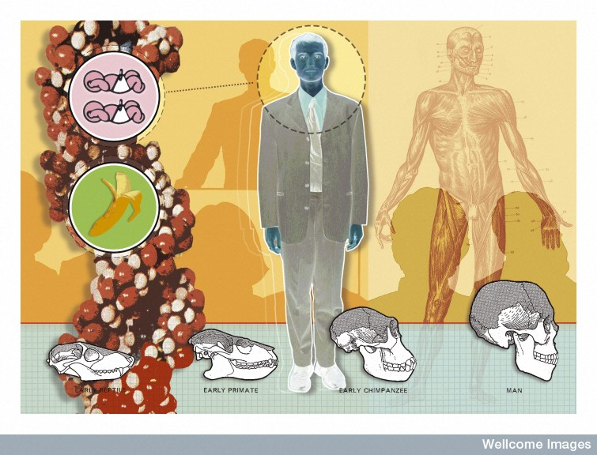
Every individual’s DNA is inherited from his or her parents, and is unique
M Herring, Wellcome Images

Slide 4
DNA profiling
Everyone’s DNA is unique (except for identical twins), half being inherited from the mother and half from the father.
The unique nature of DNA provides the basis for DNA profiling - also known as DNA fingerprinting.

Slide 5
Applications
DNA profiling can be used for establishing an individual’s identity (e.g. that of a corpse or in crime investigations), or determining their parentage. It is also used in anthropological research and for detecting genetic variations and/or mutations that may play a role in the development or progression of a disease.

Slide 6
Creating a DNA profile
A DNA profile can be created from a very tiny sample of DNA (e.g. from the saliva or a fingerprint on a glass). A profile can even be established from very old or damaged DNA.
From a single sample many copies can be produced using a technique called the polymerase chain reaction (PCR).

Slide 7
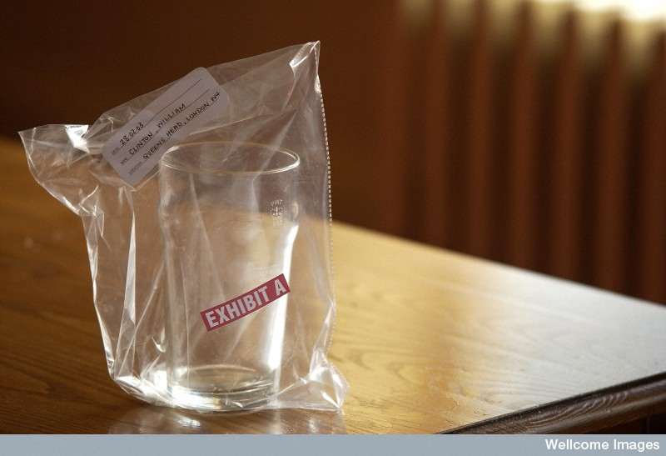
DNA forensic evidence
Wellcome Library, London

Slide 8
There are many differences in the DNA of different people and it is not practical to look at all of them.
Usually, ten key differences are studied. These DNA sequences are known to vary widely between individuals.

Slide 9
STRs
A DNA profile usually examines ten repeat base sequences, known as short tandem repeats (STRs). These DNA sequences occur on different chromosomes.
STRs occur in non-coding sections of the DNA – for example you might find the sequence CCTG repeated several times in one particular section of DNA on one chromosome.

Slide 10
A person might inherit six repeats on their mother’s chromosome and eight repeats on the matching chromosome from their father.
When the ten STRs are analysed it is highly unlikely that anyone else will share the same pattern of repeats.

Slide 11
Electrophoresis
The number of repeats determine the length of the DNA within an STR.
The DNA can be chopped up and the STRs isolated using special enzymes.
The pieces of DNA are sorted according to size using electrophoresis.

Slide 12
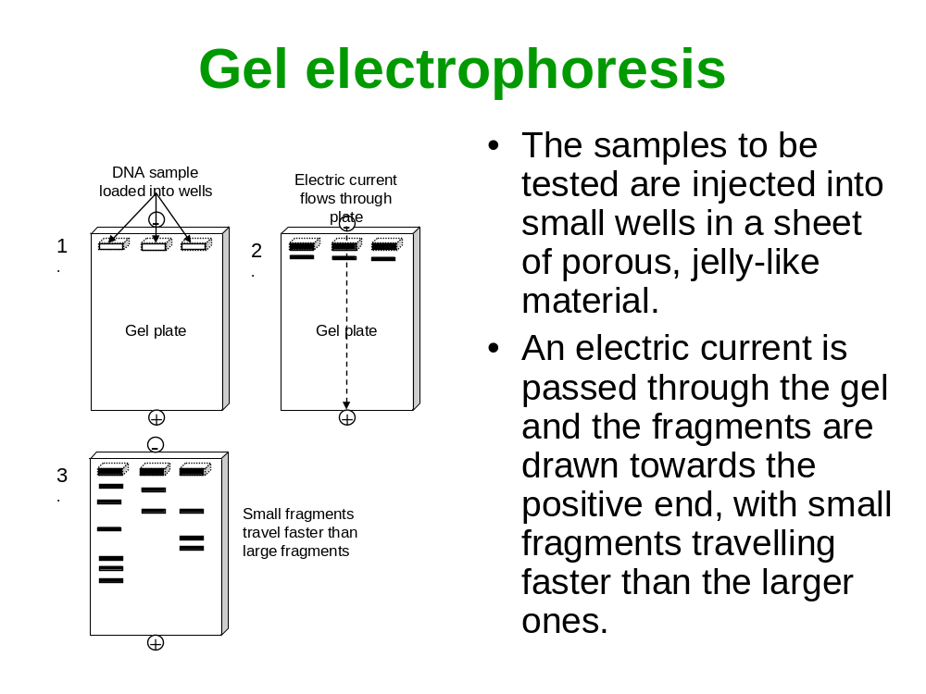

Slide 13
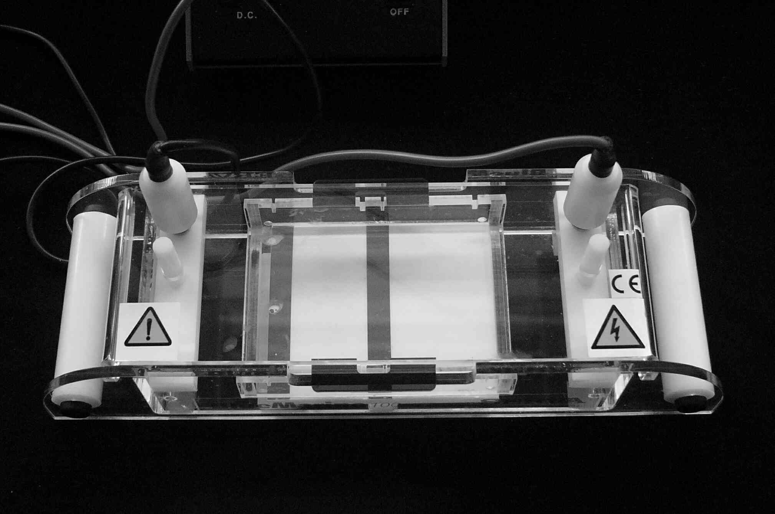
An electrophoresis cell

Slide 14
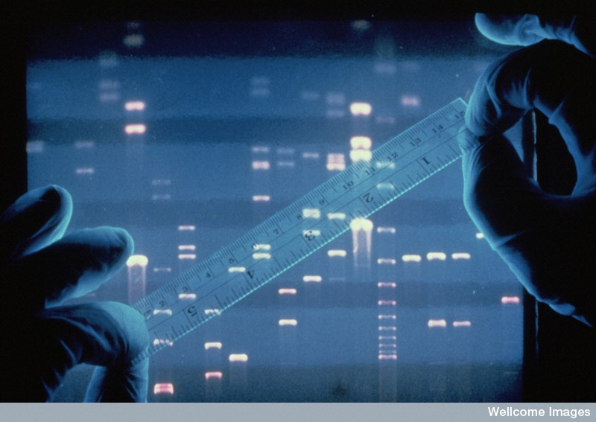
DNA profiling using gel electrophoresis
Each white band represents a segment of DNA.
The smaller fragments travel through the gel faster (and therefore further) than the heavier ones.
Wellcome Photo Library

Slide 15
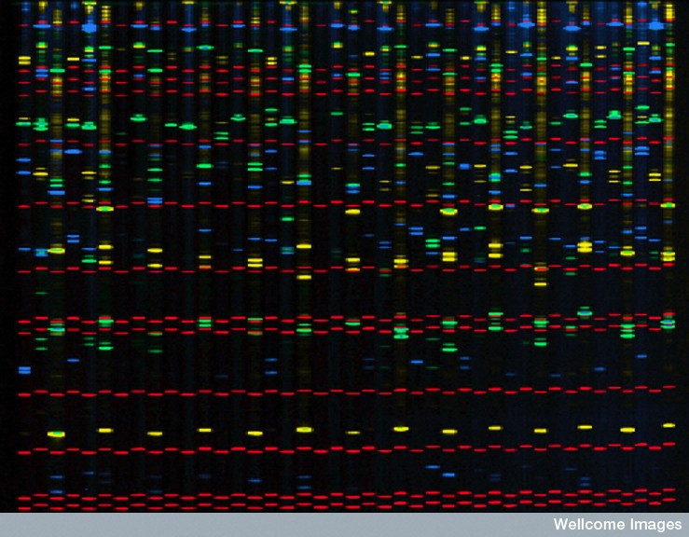
Comparitive DNA profiles of 14 unrelated people
Susan Moberly, Wellcome Images

Slide 16
The above slide shows the DNA profiles of fourteen unrelated individuals.
The green, blue and yellow bands show some similarities and some differences between individuals.
The positions of the bands show the variation in the lengths of different STRs.
The red bands are size markers.

Slide 17
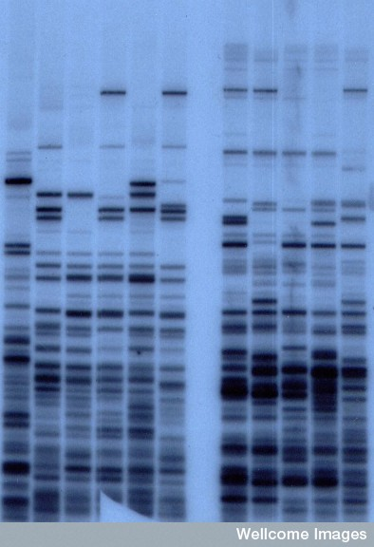
DNA patterns from a mother and her four children
DNA patterns from a mother (lanes 2 and 8) and her four children (adjacent lanes to the right). Lane 1 is an unrelated person.
A Jeffreys, Wellcome Images

Slide 18
DNA profiling can be used for detecting genetic variations and/or mutations that may play a role in the development or progression of a disease.

Slide 19
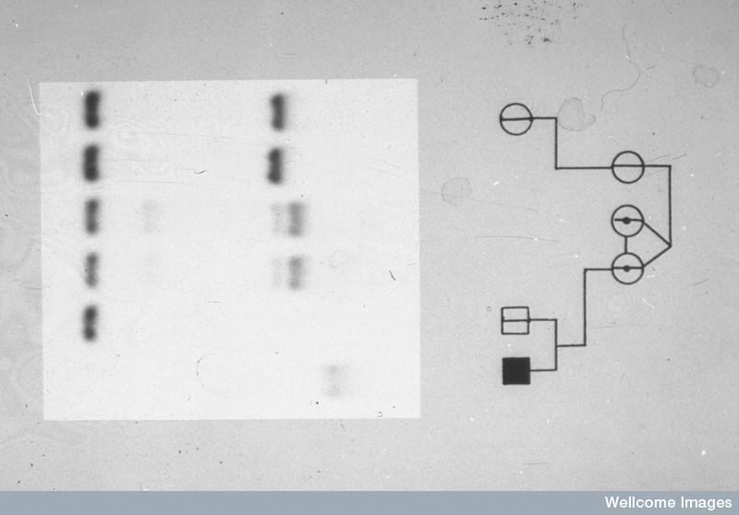
Detecting the fragile X chromosome
Repeats of the base sequence CGG are characteristic of this chromosome
Wessex Reg Genetics Centre, Wellcome Images

Slide 20
DNA sequencing
DNA sequencing is the determination of the exact order of the base pairs in a segment of DNA.

Slide 21
Polymerase chain reaction
The polymerase chain reaction (PCR) is like a biological photocopier. It is used for creating multiple copies of a specific section of DNA from a sample (DNA amplification).
PCR is useful when only small amounts of DNA are available for analysis.

Slide 22
Denaturing
The three steps in PCR are :
  denaturing
  hybridisation
  synthesis
Denaturing involves heating the DNA to separates the two strands.

Slide 23
Hybridisation
Primers (short synthetic DNA fragments) are added to the DNA.
The primers bind to complimentary base sequences on the separated DNA strands.
The primers act as starting points for the replication of new DNA molecules.

Slide 24
DNA synthesis
DNA polymerase is added.
Starting at the primer, the DNA polymerase reads the DNA code and builds a complementary strand of DNA.
Each cycle takes 3-5 minutes.

Slide 25
Polymerase chain reaction
Target gene
5’
3’
3’
5’
PCR cycle 0
1 copy of gene
HEAT
5’
3’
5’
5’
3’
5’
PRIMER
EXTENSION
PCR cycle 1
2 copies of gene
DNA polymerase
Primer A
Primer B

Slide 26
Recombinant DNA
Recombinant DNA technology, also known as genetic transformation, is the technology used in genetic engineering.
Recombinant DNA is made by recombining fragments of DNA from different sources.

Slide 27
G A A T T C
C T T A A G
Restriction enzymes cut base sequences at specific points leaving sticky ends.
G A A T T C
C T T A A G
sticky ends
A A T T
T T A A
DNA ligase is an enzyme that acts like DNA glue.
It can paste matching pieces of DNA back into the sequence.
A A T T
A A T T
T T A A
T T A A

Slide 28
Some strains of the bacterium E. coli have resistance to the antibiotic kanamycin, others have resistance to tetracycline.
Plasmid* carrying gene for kanamycin resistance
Plasmid* carrying gene for tetracycline resistance
K
T
E. coli with kanamycin resistance
E. coli with tetracycline resistance
* Plasmids are small circular pieces of DNA that occur in bacteria and protozoa. They are not in a chromosome but can replicate independently in a host cell.

Slide 29
Plasmids can be cut at specific points using restriction enzymes
K
T
The cut plasmids are mixed with DNA ligase to form recombinant DNA
K
T
Plasmid reintroduced into E. coli
E. coli with tetracycline and kanamycin resistance

Slide 30
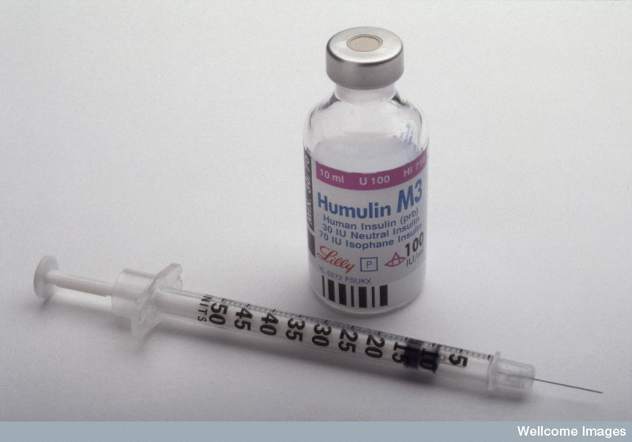
Recombinant DNA technology is used for making a range of drugs (e.g. interferon), hormones (e.g. insulin & growth hormone), and vaccines.
Many new strains of plants have been created using recombinant DNA technology.
Wellcome Library

Slide 31
Cystic fibrosis
Cystic fibrosis (CF) is a genetic condition caused by a recessive gene on chromosome 7.
The cystic fibrosis gene makes a protein that controls the movement of salt in and out of cells.
Cystic fibrosis affects several organs in the body (especially the lungs and pancreas), clogging them with mucus.
Repeated infections and blockages can cause irreversible lung damage and death.

Slide 32
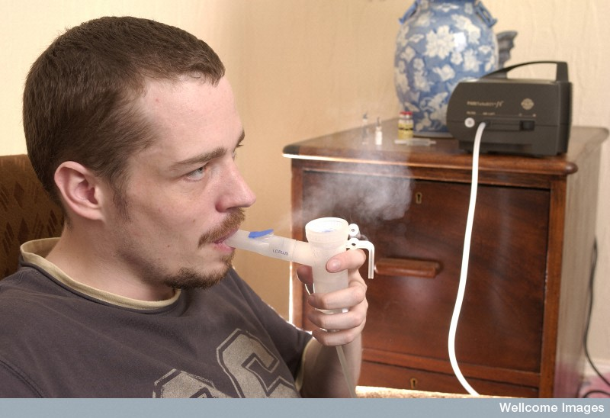
Young man with cystic fibrosis taking medication using a nebuliser.
Wellcome Library
The gene responsible for cystic fibrosis has been identified and it is hoped that, using recombinant DNA technology, it will be possible to transfer a normal copy of the gene into affected cells.

Slide 33
Gene therapy
It has long been anticipated that cystic fibrosis will be one of the first diseases to be treated by gene therapy. However, since the first clinical trials in the early 1990s numerous problems have been encountered.
It is expected that a clinically effective treatment will be available in the next 10 years.

